Slide 1
Kristin O. Bulat, JD, LLM, SVP Strategic Resources, NFP
March, 2019
Life Insurance Pitfalls & How to Avoid Them

Slide 2
Use It or Lose It

Slide 3

Don’t Get Distracted

Slide 4


Use It or Lose It
      So who is making gifts?
      Those with prior experience
      Uber wealthy
      Business Owners
      Old and/or Ill
      The “Wait & See Crowd”
Did the temporarily doubled exemption really change anything?
A married couple can give away $22M+ between the two of them – how much money do you need to have before you’re willing to give away $22M?

Slide 5
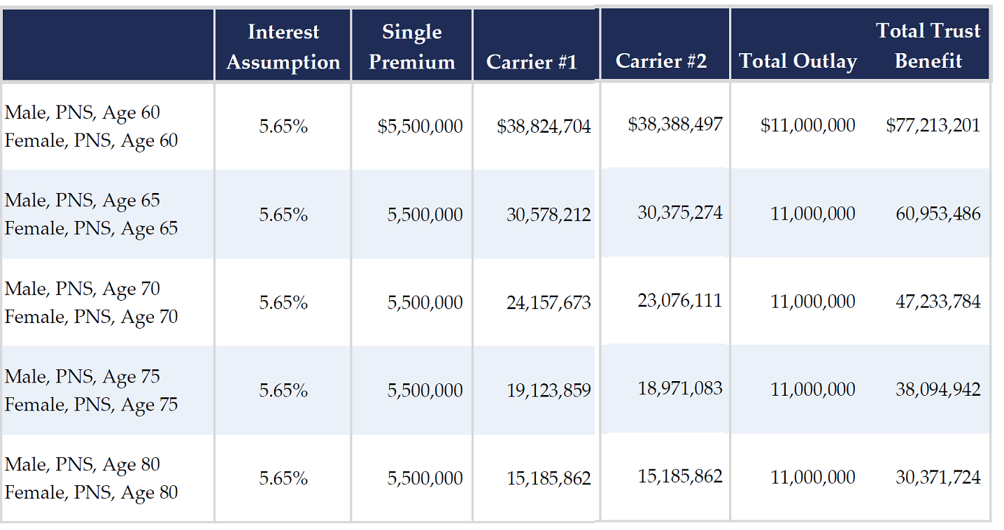
Before the Sun Sets….or 2020…

Slide 6
Buying Insurance on Sale

Slide 7

Buying Insurance on Sale
The key is to find ways to leverage discounts and arbitrage:
  Asset discounts provide the ability to transfer assets to the next generation(s) without paying taxes
    Notes
    Closely-held stock
    Appreciation
  Arbitrage takes advantage of compressed lending rates and a growing economy
    What can you do with the excess income if your assets are earning 6-7% gross and you can lend at 2.7%-3.22%?
    Why take interest rate risk when you can lock in a rate for a .52% increase?

Slide 8
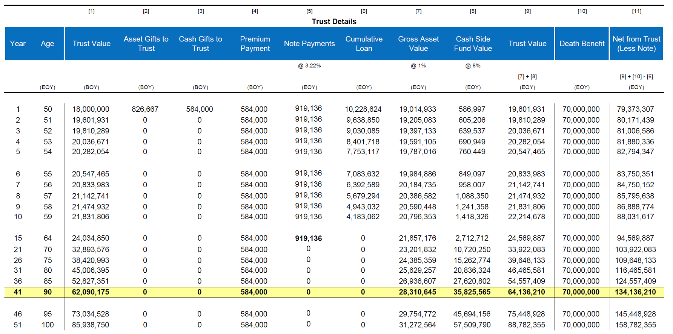
Buying Insurance on Sale – With a Sale

Slide 9
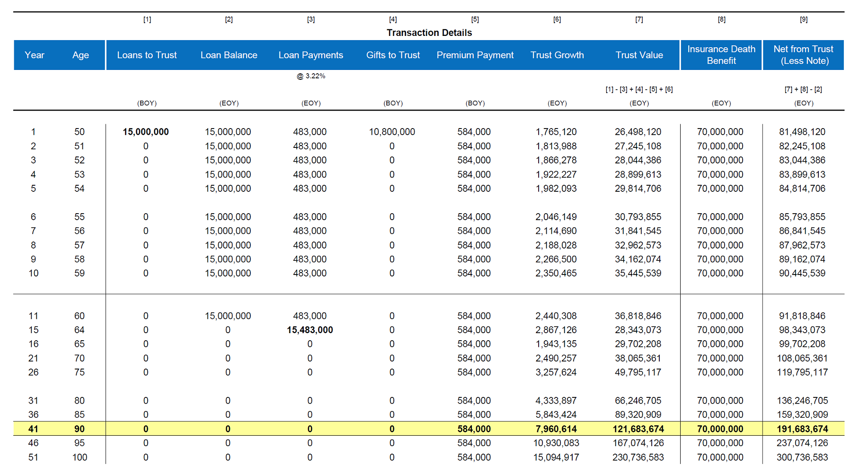
Buying Insurance on Sale – Combined Strategy

Slide 10
Buying Insurance on Sale - Discount
 |  |  | [1] | [2] |  | [3] | [4] | [5] | [6] | [7] | [8] | [9] | [10] |  | [11] | [12] | [13]
Trust Details
Year | Gen 1 Age | Gen 2 Age | Trust Value |  | Loans to Trust | Gifts to Trust | Premium Payments | Trust Growth | Annual Interest | Note Payments | Cumulative Loan | Trust Value |  | Insurance Cash Value for Gen 2 | Death Benefit on Gen 2 | Net from Trust with CV | Net from Trust with DB
 |  |  |  |  |  |  |  | @ 8% | @ 2.99% |  |  | [1] + [2] + [3] - [4] + [5] - [7] |  |  |  | [9] + [10] - [8] | [9] + [11] - [8]
 | (EOY) | (EOY) | (BOY) |  | (BOY) | (BOY) | (BOY) | (EOY) | (EOY) | (EOY) | (EOY) | (EOY) |  | (EOY) | (EOY) | (EOY) | (EOY)
1 | 48 | 19 | 0 |  | 50,000,000 | 0 | 2,000,000 | 3,840,000 | 1,495,000 | 1,495,000 | 50,000,000 | 50,345,000 |  | 676,259 | 130,804,448 | 51,021,259 | 131,149,448
2 | 49 | 20 | 50,345,000 |  | 0 | 0 | 2,000,000 | 3,867,600 | 1,495,000 | 1,495,000 | 50,000,000 | 50,717,600 |  | 1,955,527 | 131,667,685 | 52,673,127 | 132,385,285
3 | 50 | 21 | 50,717,600 |  | 0 | 0 | 2,000,000 | 3,897,408 | 1,495,000 | 1,495,000 | 50,000,000 | 51,120,008 |  | 3,928,048 | 132,632,663 | 55,048,056 | 133,752,671
4 | 51 | 22 | 51,120,008 |  | 0 | 0 | 2,000,000 | 3,929,601 | 1,495,000 | 1,495,000 | 50,000,000 | 51,554,609 |  | 5,991,833 | 133,694,096 | 57,546,442 | 135,248,705
5 | 52 | 23 | 51,554,609 |  | 0 | 0 | 2,000,000 | 3,964,369 | 1,495,000 | 1,495,000 | 50,000,000 | 52,023,977 |  | 8,159,732 | 134,890,637 | 60,183,709 | 136,914,614
6 | 53 | 24 | 52,023,977 |  | 0 | 0 | 2,000,000 | 4,001,918 | 1,495,000 | 1,495,000 | 50,000,000 | 52,530,896 |  | 10,450,231 | 136,329,100 | 62,981,127 | 138,859,996
7 | 54 | 25 | 52,530,896 |  | 0 | 0 | 2,000,000 | 4,042,472 | 1,495,000 | 1,495,000 | 50,000,000 | 53,078,367 |  | 12,865,565 | 137,997,234 | 65,943,932 | 141,075,601
8 | 55 | 26 | 53,078,367 |  | 0 | 0 | 2,000,000 | 4,086,269 | 1,495,000 | 1,495,000 | 50,000,000 | 53,669,637 |  | 15,414,770 | 139,893,954 | 69,084,407 | 143,563,591
9 | 56 | 27 | 53,669,637 |  | 0 | 0 | 2,000,000 | 4,133,571 | 1,495,000 | 1,495,000 | 50,000,000 | 54,308,207 |  | 18,104,535 | 142,017,084 | 72,412,742 | 146,325,291
10 | 57 | 28 | 54,308,207 |  | 0 | 0 | 2,000,000 | 4,184,657 | 1,495,000 | 1,495,000 | 50,000,000 | 54,997,864 |  | 20,945,652 | 144,393,020 | 75,943,516 | 149,390,884
15 | 62 | 33 | 68,087,349 |  | 0 | 0 | (6,000,000) | 4,726,988 | 0 | 15,000,000 | 0 | 63,814,337 |  | 21,424,085 | 131,879,455 | 85,238,422 | 195,693,792
20 | 67 | 38 | 86,818,701 |  | 0 | 0 | 0 | 4,375,663 | 0 | 0 | 0 | 91,194,364 |  | 28,463,601 | 146,279,855 | 119,657,965 | 237,474,219
25 | 72 | 43 | 111,016,326 |  | 0 | 0 | 0 | 5,595,223 | 0 | 0 | 0 | 116,611,549 |  | 37,673,375 | 161,967,110 | 154,284,924 | 278,578,659
30 | 77 | 48 | 141,958,178 |  | 0 | 0 | 0 | 7,154,692 | 0 | 0 | 0 | 149,112,870 |  | 49,721,470 | 179,422,597 | 198,834,340 | 328,535,467
35 | 82 | 53 | 181,523,970 |  | 0 | 0 | 0 | 9,148,808 | 0 | 0 | 0 | 190,672,779 |  | 65,462,863 | 199,779,080 | 256,135,642 | 390,451,859
40 | 87 | 58 | 232,117,320 |  | 0 | 0 | 0 | 11,698,713 | 0 | 0 | 0 | 243,816,033 |  | 85,871,792 | 223,893,097 | 329,687,825 | 467,709,130
45 | - | 63 | 296,811,766 |  | 0 | 0 | 0 | 14,959,313 | 0 | 0 | 0 | 311,771,079 |  | 112,179,367 | 252,380,662 | 423,950,446 | 564,151,741
50 | - | 68 | 379,537,488 |  | 0 | 0 | 0 | 19,128,689 | 0 | 0 | 0 | 398,666,177 |  | 145,914,581 | 285,505,226 | 544,580,758 | 684,171,403
72 |  | 90 | 1,119,588,338 |  | 0 | 0 | 0 | 89,567,067 | 0 | 0 | 0 | 1,176,015,591 |  | 398,631,444 | 486,254,605 | 1,574,647,035 | 1,662,270,196

Slide 11
Alphabet Soup

Slide 12

Alphabet Soup
Let’s employ a LIRP strategy in an DIGT for HENRYs using 162, SLATs and LTC!

Slide 13
Alphabet Soup: LIRP for HENRYs in SLATs
 |  | [1] | [2] | [3] | [4] | [5] | [6] | [7] | [8] | [9] | [10] | [11] | [12] | [13]
 |  | Permanent Life Insurance |  |  |  |  | Term Life Insurance with Taxable Investment |  |  |  |  |  | Increase / (Decrease)
Year | Age | Net Outlay | Net Cash Surrender Value | Net Death Benefit | IRR on Cash Value | IRR on Death Benefit | Net Outlay | Death Benefit | Taxable Investment / (Income) | Growth | Investment Account Balance | Total Value to Heirs | Cash Value | Value to Heirs
 |  |  |  |  |  |  |  |  |  | @ 3.5% A/T |  |  | [2] - [10] | [3] - [11]
 | (EOY) | (BOY) | (EOY) | (EOY) | (EOY) | (EOY) | (BOY) | (EOY) | (BOY) | (EOY) | (EOY) | (EOY) | (EOY) | (EOY)
1 | 46 | 50,000 | 16,021 | 1,047,121 | -67.96% | 1994.24% | 1,235 | 1,000,000 | 48,765 | 1,707 | 50,472 | 1,050,472 | (34,451) | (3,351)
2 | 47 | 50,000 | 46,429 | 1,054,614 | -41.44% | 311.98% | 1,235 | 1,000,000 | 48,765 | 3,473 | 102,710 | 1,102,710 | (56,281) | (48,096)
3 | 48 | 50,000 | 93,317 | 1,069,384 | -21.92% | 137.39% | 1,235 | 1,000,000 | 48,765 | 5,302 | 156,777 | 1,156,777 | (63,460) | (87,393)
4 | 49 | 50,000 | 144,472 | 1,090,853 | -12.59% | 81.18% | 1,235 | 1,000,000 | 48,765 | 7,194 | 212,736 | 1,212,736 | (68,264) | (121,883)
5 | 50 | 50,000 | 200,142 | 1,118,959 | -7.32% | 54.97% | 1,235 | 1,000,000 | 48,765 | 9,153 | 270,653 | 1,270,653 | (70,511) | (151,694)
6 | 51 | 50,000 | 258,895 | 1,148,837 | -4.20% | 40.17% | 1,235 | 1,000,000 | 48,765 | 11,180 | 330,598 | 1,330,598 | (71,703) | (181,761)
7 | 52 | 50,000 | 320,871 | 1,180,520 | -2.17% | 30.84% | 1,235 | 1,000,000 | 48,765 | 13,278 | 392,641 | 1,392,641 | (71,770) | (212,121)
8 | 53 | 50,000 | 386,282 | 1,214,248 | -0.78% | 24.53% | 1,235 | 1,000,000 | 48,765 | 15,449 | 456,855 | 1,456,855 | (70,573) | (242,607)
9 | 54 | 50,000 | 455,308 | 1,250,020 | 0.23% | 20.03% | 1,235 | 1,000,000 | 48,765 | 17,697 | 523,316 | 1,523,316 | (68,008) | (273,296)
10 | 55 | 50,000 | 528,146 | 1,287,909 | 0.99% | 16.70% | 1,235 | 1,000,000 | 48,765 | 20,023 | 592,104 | 1,592,104 | (63,958) | (304,195)
15 | 60 | 0 | 698,030 | 1,467,435 | 3.19% | 10.38% | 1,235 | 1,000,000 | (1,235) | 23,549 | 696,380 | 1,696,380 | 1,650 | (228,945)
20 | 65 | 0 | 917,939 | 1,683,025 | 3.96% | 7.98% | 1,235 | 1,000,000 | (1,235) | 27,737 | 820,226 | 1,820,226 | 97,713 | (137,201)
25 | 70 | (66,561) | 809,731 | 1,312,751 | 4.27% | 6.11% | 0 | 0 | (66,561) | 20,450 | 604,748 | 604,748 | 204,983 | 708,003
30 | 75 | (66,561) | 664,342 | 1,044,471 | 4.41% | 5.42% | 0 | 0 | (66,561) | 11,796 | 348,827 | 348,827 | 315,515 | 695,644
35 | 80 | (66,561) | 470,641 | 814,494 | 4.47% | 5.16% | 0 | 0 | (66,561) | 1,517 | 44,873 | 44,873 | 425,768 | 769,621
40 | 85 | (66,561) | 204,111 | 504,816 | 4.47% | 4.95% | 0 | 0 | 0 | 0 | 0 | 0 | 204,111 | 504,816
42 | 87 | 0 | 212,176 | 494,573 | 4.45% | 4.86% | 0 | 0 | 0 | 0 | 0 | 0 | 212,176 | 494,573
45 | 90 | 0 | 211,001 | 467,041 | 4.41% | 4.74% | 0 | 0 | 0 | 0 | 0 | 0 | 211,001 | 467,041
50 | 95 | 0 | 161,669 | 365,388 | 4.29% | 4.52% | 0 | 0 | 0 | 0 | 0 | 0 | 161,669 | 365,388
55 | 100 | 0 | 122,002 | 122,002 | 4.21% | 4.21% | 0 | 0 | 0 | 0 | 0 | 0 | 122,002 | 122,002

Slide 14
Business Goals: The Three R’s

Slide 15

The Three R’s: Retain, Reward, & Recruit

Slide 16
Simple, But Effective, Employee Retention Plan

Slide 17
Now, Let’s Put a Twist on the Old Classic

Slide 18
It’s Fun to be Tax-Exempt, Right??

Slide 19

Non-Profit Employees Want to Retire Too
Non-profits were already facing three challenges as they tried to recruit, retain & reward employees:
Competition with employers in the for-profit space;
Public reporting of all income paid to employees; and
457(b) & 457(f) plan limitations
Then Congress added the final straw – an excise tax on excess compensation paid to employees.
If the excise tax is triggered, the non-profit employer owes 21% on all compensation over the threshold
The excise tax is triggered:
  Compensation over $1M for top 5 HCE, calculated annually
  “Parachute payments” greater than 3X the 5-year final average salary paid to employees making over $120k.

Slide 20


Come and Get Your Tax-Free Retirement Income!
Loan Regime Split Dollar: An Answer to all the Problems!
Employee Compensation: cash value can be accessed income tax free, maximizing potential retirement income
Income taxes: employees pick up loan interest as income rather than large lump sum plus taxable retirement income
Non-profit receives cost recovery through loan repayment, an option not available through other retirement plans.

Slide 21
How’s It Going to Work?

Slide 22
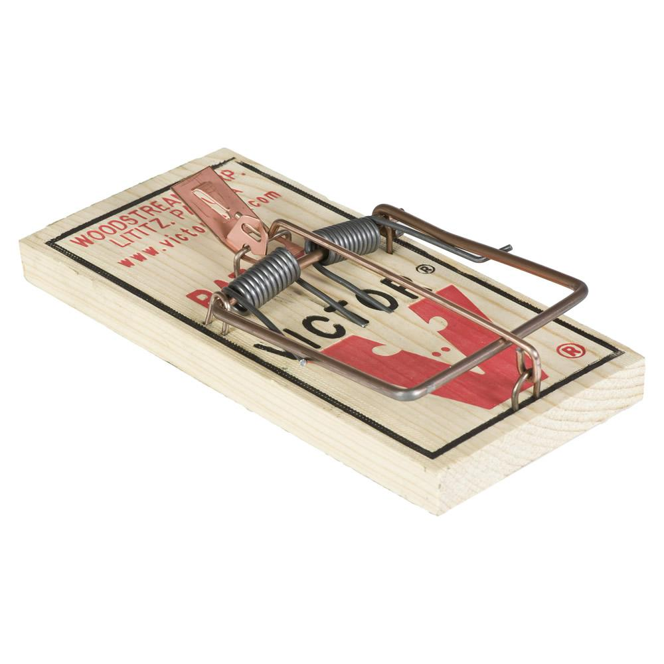
Bonus Traps!

Slide 23
Bonus Traps!
Investment Decisions
  Premium allocation based on intended use
  Reasonable assumption
  Regular tracking
Policy Management
  Premium payment impacts guarantees
  Health changes
  Beneficiary designation/beneficiary needs change
  Temporary thinking
Client Management
  Regular check-ins
  1035 – just because it’s cool?
  101(j) & 8925

Slide 24

www.NFP.com

